Slide 1
NVL Ax RVP strategy
NVL RVP Architecture
Deepak, Mayank, Ranganadh, Manju, Sachin, Mani
WW15p5Y2025
Rev0.50

Slide 2
RVP SKU Strategy History
WW26p1 : RVP Rev0p0.5 - SKU Strategy for NVL Ax PC
WW08p1’2025: Rev0p0.55 - Ax02- HSIO SKU dropped post alignment with NVL Ax FV team, integration of AM SKU requirements on same RVP.
WW15p5’2025: Rev0p0.70 - Added Risk and Open towards EC

Slide 3
NVL AX/AM RVP Strategy
Silicon/ Package info
NVL AX/AM RVP SKU Strategy
Segment | CPU | GPU & NPU | PL1 Range | Memory
AX/AM | 8+16+4/4+8+4 | 512EU/256EU & NPU7 - 6Tile | 35W-60W-70W | LP5x MD @ 10.7 GT/s- MOP
NVL Ax T3 Socketed RVP
PDG + Primary SKU
NVL Ax T3 Socketed HSIO RVP*
This SKU is TBD
HSIO/EV/SI/PI/PPV -WIP
Golden BKC, PnP
EV/SI/PI, GFx, PPV , ECG(IOTG)
Ax 01
Opens:
100WcTDP PL1 support on RVP - Bigger HS will impact KOZ around CPU
Risk: 125W TDP PL1 support on RVP [ECG] - Bigger HS will impact KOZ around CPU and may impact RVP SKU strategy [ VR design change, PCB change etc], PD and thermal data awaited
Check Point – WW24 for 125W data, impact analysis to RVP post reception of power numbers.
Memory Validation plan with MOP
Minimum EV specific topologies (min/ max/ re driver less etc) Support [ request to leverage NVL-HX EV data] , yet to finalize w.r.t. RVP floorplan, can potentially affect RVP IO mapping.
DROPPED
Ax 02
RVP strategy assumptions
Only T3 RVP SKU
Discrete only PD Solution.
Ax 02 SKU is placeholder only - Dropped
Single RVP to support Both AX & AM Silicon. No Over clocking support.
PCH IOE support is motherboard down with support limited to HSIO for SSD
RVP BOM sku will be considered to support w/o PCH IOE Config
HSIO FV/EV Support: No FV specific AIC support, ask to leverage data from NVL Hx RVP. – Alignment done with HSIO FV team, no separate HSIO RVP to be supported.

Slide 4
NVL Ax/Am RVP BOM SKU's
Segment | Base Board# | RVP SKU | Base board SKU/ BOM SKU | RVP SKU Code | RVP Base board SKU + BOM SKU (Please note - SKU name will change later with MySamples Tool name) | Validation Config | SoC Support | PCH IOE Support (Mother Board Socketed) | PCB Type (POR L# + RVP L#)
Ax | Ax/Am 01 RVP | NVL Ax/Am LP5x MOP T3 with PCH IOE RVP | Base Board SKU | Ax-011 | NVL Ax/Am LP5x MOP T3 | Volume runner | NVL Ax/Am SoC | With Out PCH IOE | Type-3, 10L+6L
 |  |  | BOM SKU | Ax-012 | NVL Ax/Am LP5x MOP T3 | PnP SKU |  | With Out PCH IOE
 |  |  | PPV Board SKU | Ax-013 | NVL Ax/Am LP5x MOP T3 with PCH IOE PPV RVP | PPV |  | TBD
 |  |  | BOM SKU | Ax-014 | NVL Ax/Am LP5x MOP T3 with PCH IOE RVP |  |  | With PCH IOE
 |  |  | BOM SKU | Ax-015 | NVL Ax/Am LP5x MOP T3 with PCH IOE RVP | ECG |  | With PCH IOE
 |  |  | BOM SKU | Ax-016 | NVL Ax/Am LP5x MOP T3 | Memory DV |  | TBD
 |  |  | BOM SKU (Placeholder) | Ax-017 | AM Specific (PI Changes) BOM SKU- TBD |  |  | TBD

Slide 5
Opens: To be closed by RVP Team
Socket Design Strategy Closure
VR Controller finalization and enabling

Slide 6
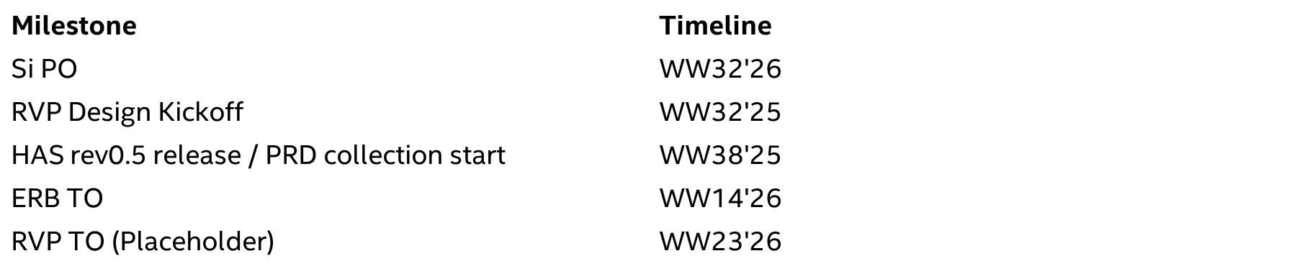
Tentative Schedule:

Slide 7
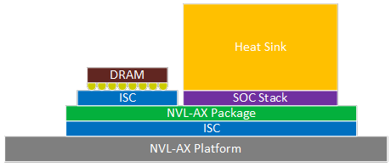
SOCKET Mechanical Design Challenges
Temperature range: The thermal solution needs to be redefined. We need to find out the required temperature validation range.
Wattage: the package is much bigger than LNL. It will be a socket design challenge.
DV, EV and FV validation requirements. It depends on each discipline's needs; multiple memory interposers need to be designed. The RVP KOZ also needs to be defined.
Memory socket design: The horseshoe like memory placement is on the package..
Priolo, Matthew G

Slide 8
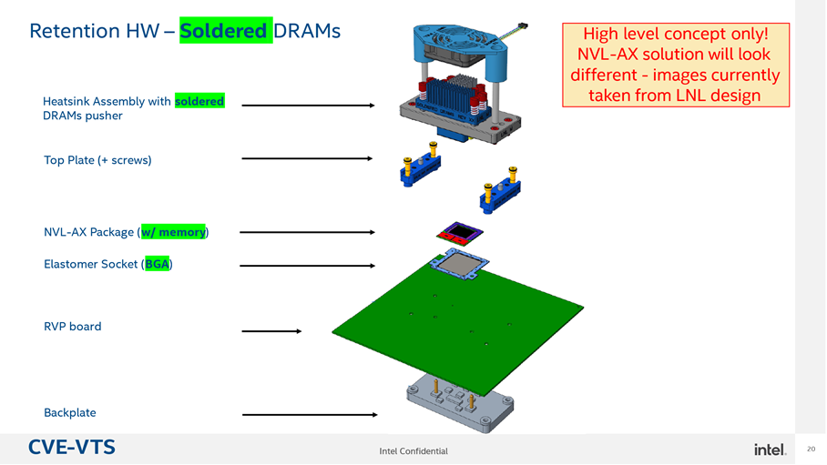
Memory Socket Scheme for RVP
Socket Development for RVP : Initial plan to scale LNL solution to NVL Ax.
ACK: Atkins, Aviva

Slide 9
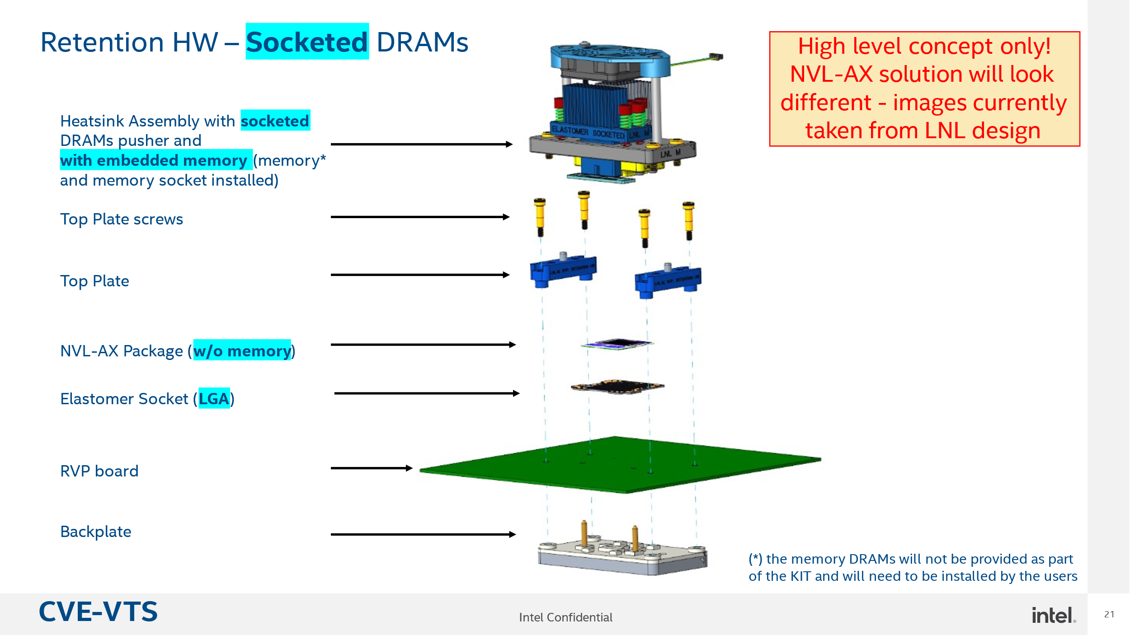
Memory Socket Scheme for RVP
ACK: Atkins, Aviva

Slide 11
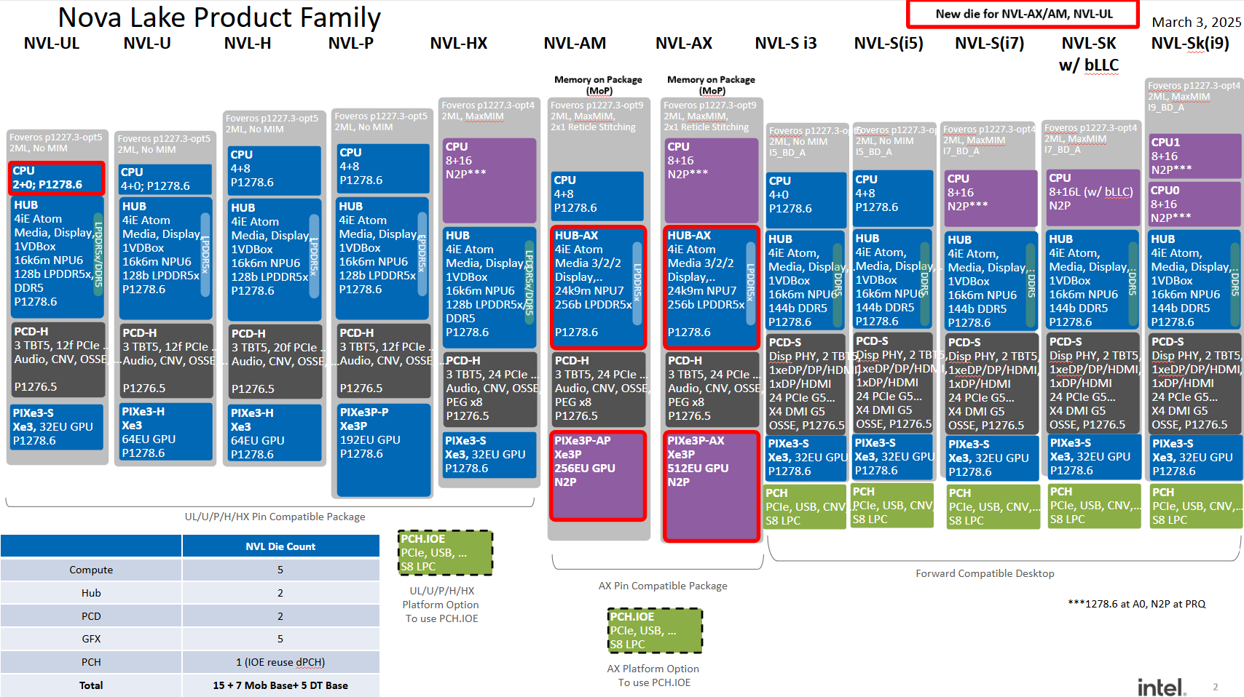

Slide 12
New RVP Requirements for OSAT Testing
Ask: Cost efficient smaller FF RVP to increase testing throughput at OSAT
Data Awaited:
Board Size versus throughput O/P- From OSAT Vendor: Need data to understand correlation between board size versus testing throughput at OSAT
Testing samples per week requirements at OSAT- From ATTD
Propose Solution:
If throughput is not a concern: Optimized RVP BOM SKU with debug hooks, connectors and not required interfaces circuitry unpopulated
If throughput is concern:
New RVP with smaller FF, less layer count and limited interfaces support for memory testing requirements : New RVP to be added and designed.
Two Board RVP approach: Main board: POR interfaces and limited debug hooks, Secondary board: Noncritical debug hooks. Avoid any new RVP Spin. To be intercepted in given RVP.

